Slide 1


Presented by Tyler Fernandez
Salifort Motors: machine learning with Python capstone
Analysis and recommendations
https://github.com/TylerF15/Google-ada-capstone

Slide 2


Introduction
Google Advanced Data Analytics capstone
Python based analysis
Use data analysis & machine learning models to predict an outcome
Goals
Data cleaning
Explore trends and relationships
Data pre-processing
Process data, create new variables for model ingestion
Construct three models:
Model evaluation and summary
Provide recommendations to leadership
Deliverables
Initial data analysis summary
Model evaluation and interpretation
Data visualizations
Ethical considerations
Recommendations for stakeholders and leaders.

Slide 3
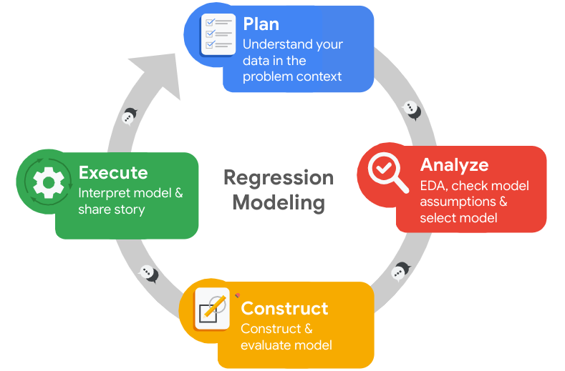
Methodology used in analysis and model creation
This project utilized the PACE framework: Plan, Analyze, Construct, and Execute.
Throughout the stages, I will ask myself certain questions, such as:
Who are my stakeholders for this project?
What am I trying to accomplish?
What are my ethical concerns at this stage?
What observations do I have regarding the data?
What are the relationships between variables?
How well does my model fit the data?
Can my model be improved?
Which model performed best?

Slide 4
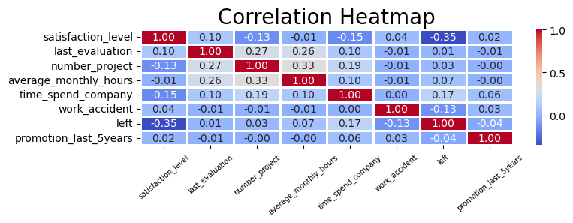
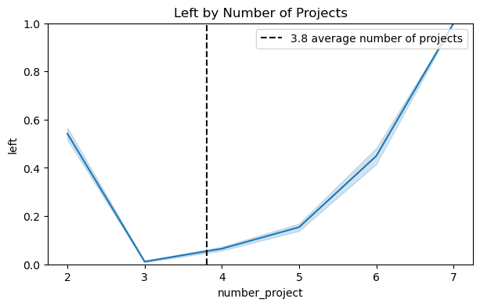
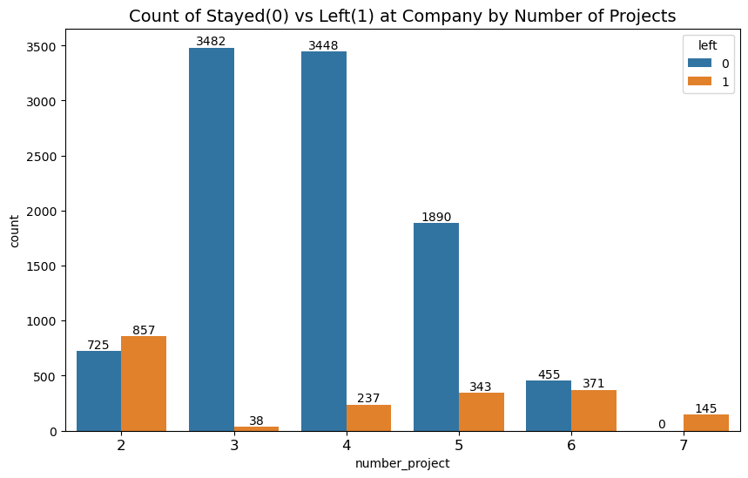
Overview of trends and relationships

Slide 5
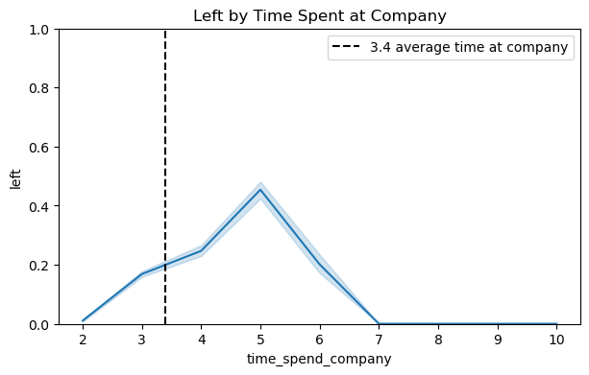
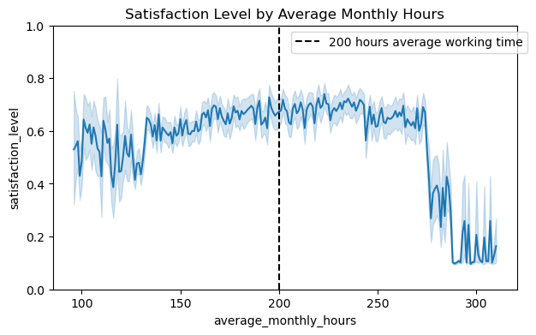
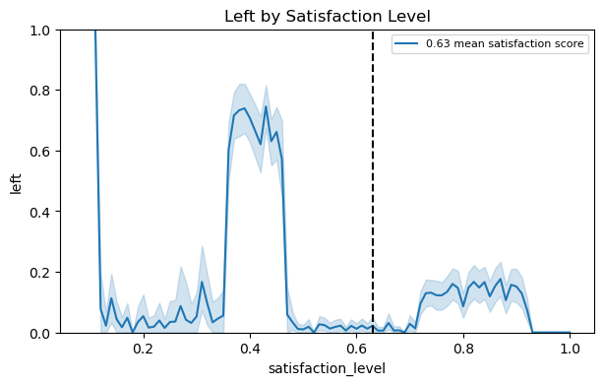
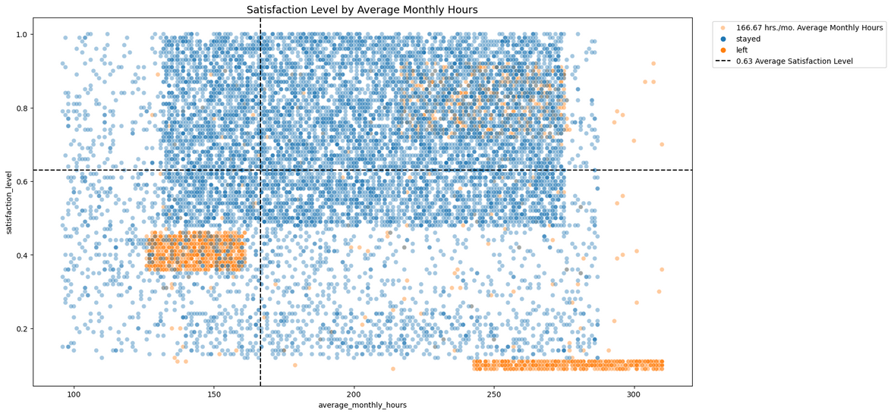
Overview of trends and relationships continued

Slide 6
Overview of machine learning models
01.
02.
03.
Binomial Logistic Regression
Decision Tree
Random Forest

Slide 7
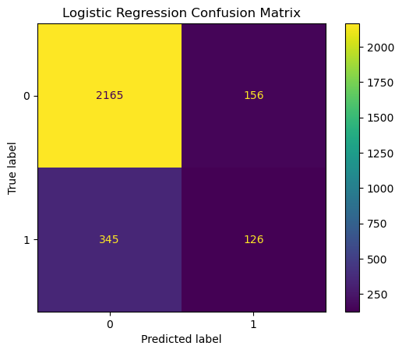
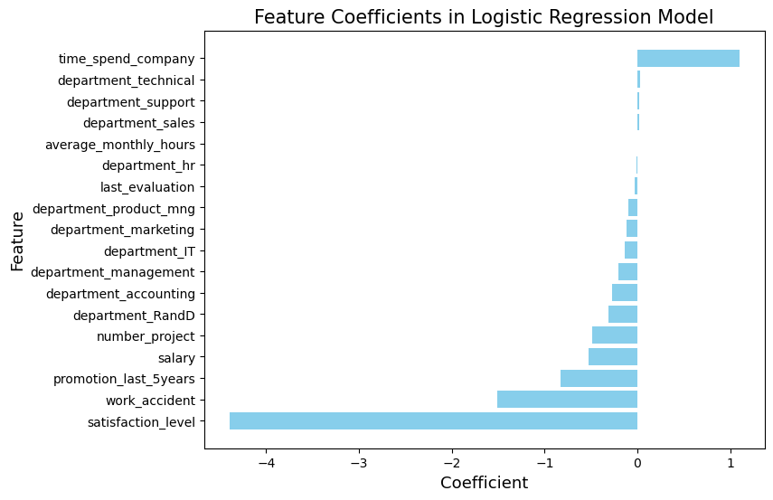
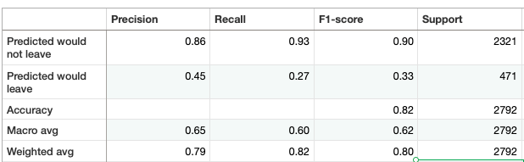

Overview of Binomial Logistic Regression model

Slide 8
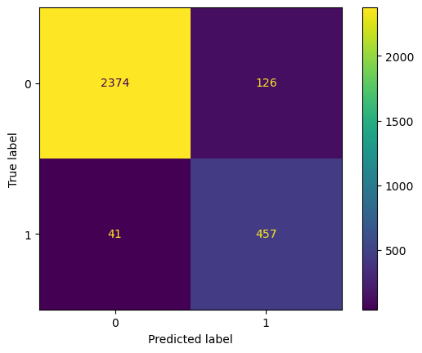
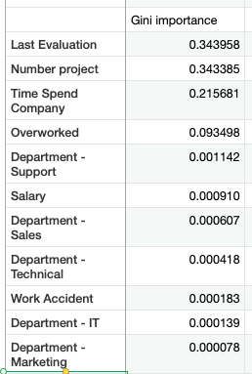
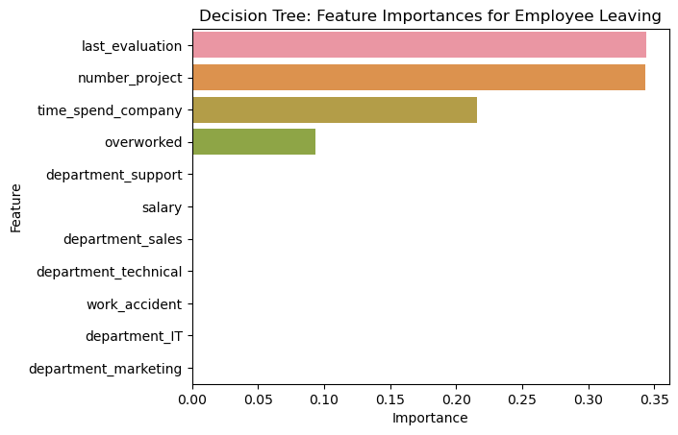
Overview of Decision Tree model

Slide 9

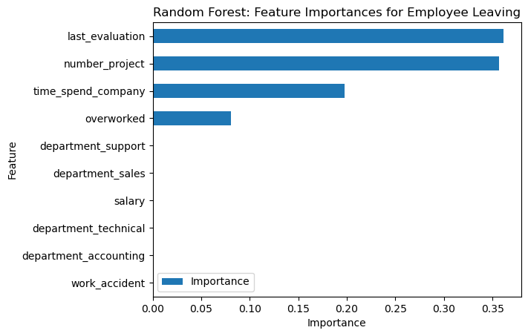
Overview of Random Forest model

Slide 10
Champion model: Random Forest
Evaluation Metrics and performance
AUC: Area under the ROC curve. Also considered the probability that the model ranks a random positive example more highly than a random negative example.
Precision: The proportion of positive predictions that are true positives.
Recall: It measures the proportion of positives that are correctly classified.
Accuracy: Measures the proportion of data points that are correctly classified.
F1 score: an aggregation of Precision and Recall scores.

Slide 11

Analysis, Recommendations, and Model Implementation
Employee Satisfaction:
Focus on strategies to enhance employee satisfaction, addressing specific concerns and improving the overall work environment.
Regularly assess employee satisfaction levels to identify and mitigate potential issues proactively.
Workload Management:
Establish a balanced workload by managing the number of projects and average monthly hours to prevent employee burnout and dissatisfaction.
Employee Development:
Foster career development opportunities, ensuring that promotions and recognitions are distributed fairly and transparently.
Model Utilization:
Employ the predictive models, particularly Random Forest or XGBoost, to forecast potential employee churn, allowing for timely interventions.
Continuously update and refine the models to adapt to evolving organizational dynamics and employee behaviors.

Slide 12

Next steps
Further develop the dataset and variables
Determine the level of accuracy and other evaluation metrics needed to use the model in any real way, such as workforce planning, business development, employee management, and so on
Ensuring this model is used ethically and legally is imperative

